Slide 1
Employee Data Analysis using Excel
STUDENT NAME: PRADEESWARI. VD
REGISTER NO: 122201932 asunm135122/cp/74
DEPARTMENT:B.COM CORPORATE SECRETARYSHIP
COLLEGE: CHEVALIER T.THOMAS ELIZABETH COLLEGE FOR WOMEN

Slide 2
PROJECT TITLE
Employee Performance Analysis using Excel

Slide 3


AGENDA
Problem Statement
Project Overview
End Users
Our Solution and Proposition
Dataset Description
Modelling Approach
Results and Discussion
Conclusion
3/21/2024 Annual Review

Slide 4

PROBLEM STATEMENT
For Achievement
For Salary Enhancement
Carefully consider different viewpoints and approaches before making decisions.
Consistently shows a high ability to resolve intricate issues with effectiveness.

Slide 5

PROJECT OVERVIEW
.
Evaluate employee performance by considering factors like gender, performance scores, and ratings to uncover trends and patterns among various employee groups (high, medium, low). Assess their strengths and weaknesses, and propose actionable goals for enhancement.

Slide 6

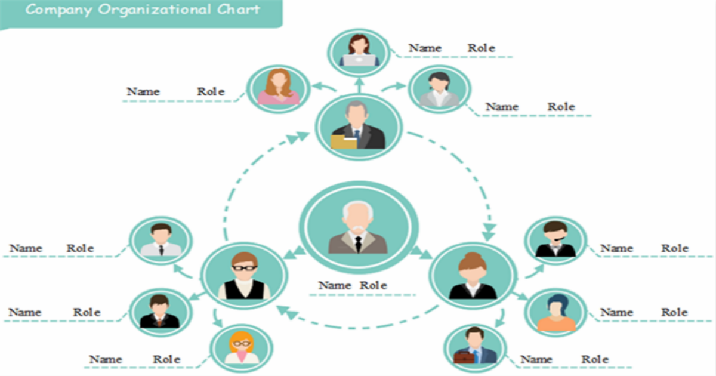

WHO ARE THE END USERS?

Slide 7

OUR SOLUTION AND ITS VALUE PROPOSITION
Conditional Formatting: Omission
Filter: Exclude
Formula: Effectiveness
Pivot: Summary
Graph: Data Visualization

Slide 8
Employee Data Description
First Name
Last Name
Gender
Business Unit
Performance Score
Current Employee Rating
Credit Rating Performance

Slide 9

THE "WOW" IN OUR SOLUTION
PERFORMANCE LEVEL = ==IFS( F2 >= 4, "Good", F2 = 2, "Average", F2 <= 1, "Bad" )
3/21/2024 Annual Review
9

Slide 10
MODELLING
DATA COLLECTION
GAGGLE TO DOWNLOAD THE DATA
FETURE COLLECTION
Employee Status
Employee Type
Gender Code
Performance Score
Current Employee Rating
DATA CLEANING
MISSING VALUE IDENTIFY
MISSING VALUE FILTER
PERFORMANCE LEVEL
Bar , Pie Diagram, Line Chart
SUMMARY
10

Slide 11
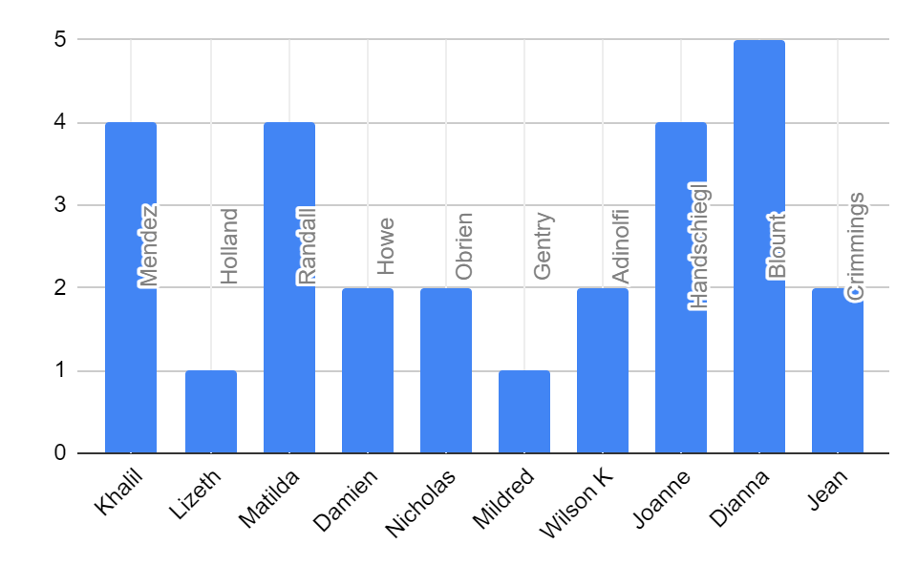
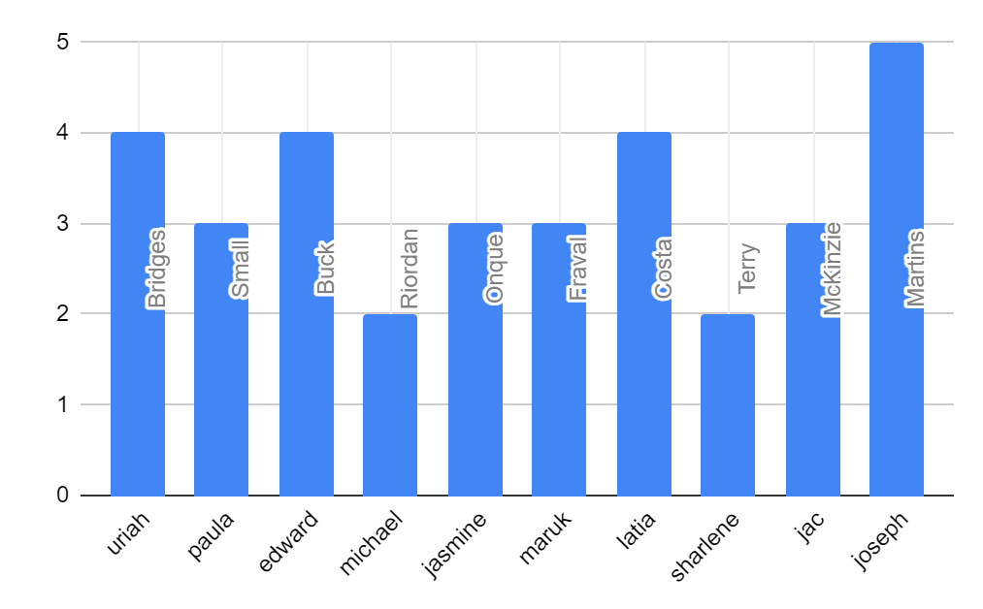
RESULTS
11

Slide 12
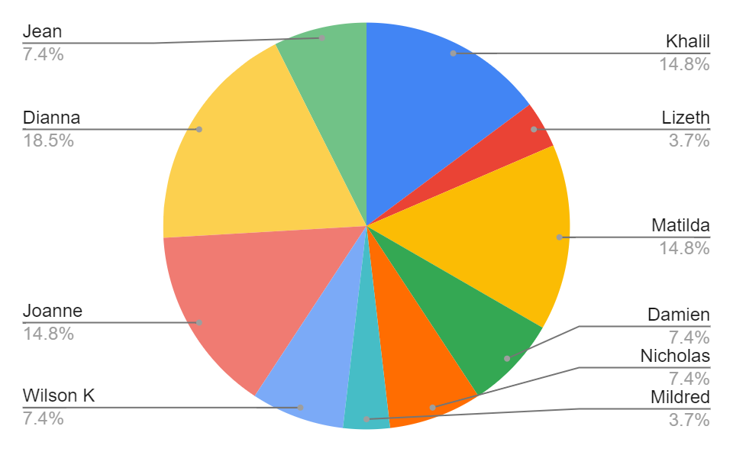
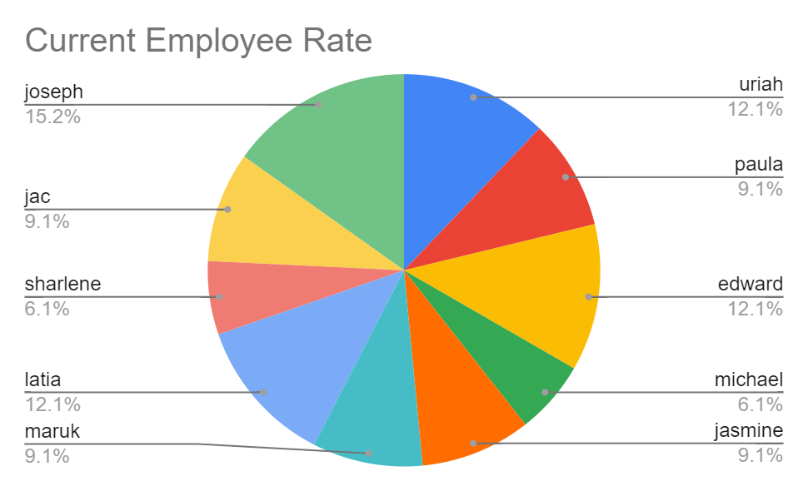
RESULTS

Slide 13
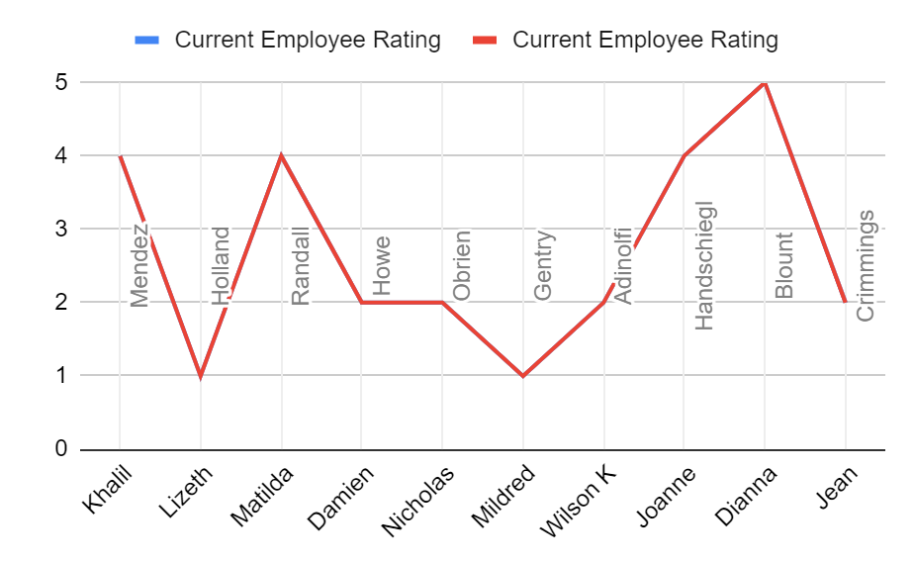
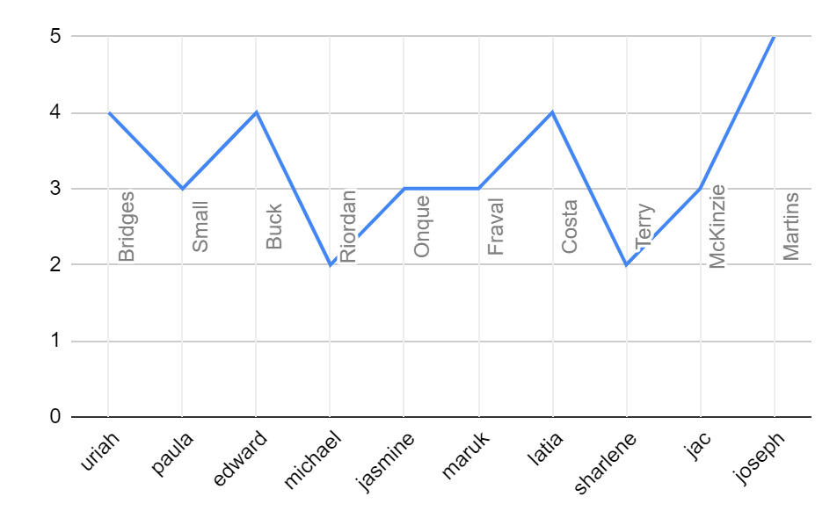
RESULTS

Slide 14
conclusion
Upon reviewing employee performance, it is noted that there is a distribution of employees across categories of Good, Bad, and Average performance. To address this, we should allocate tasks of different complexities based on their performance levels and job roles. Effective motivation is crucial for improving results.

